Slide 1
Candy Analysis
Ian O’Keeffe

Slide 2
Data Source
The data was gathered by David Ng at The University of British Columbia, and originally published in The Science Creative Quarterly.
Source: https://www.scq.ubc.ca/so-much-candy-data-seriously/

Slide 3

Motivation
Innovation Finding trends can help manufacturers develop candies that meet demand
Marketing Finding which demographics enjoy which candy enables more targeted marketing
Logistics Finding unexpected demand for candy in other countries can help direct manufacturing and shipping efforts

Slide 4
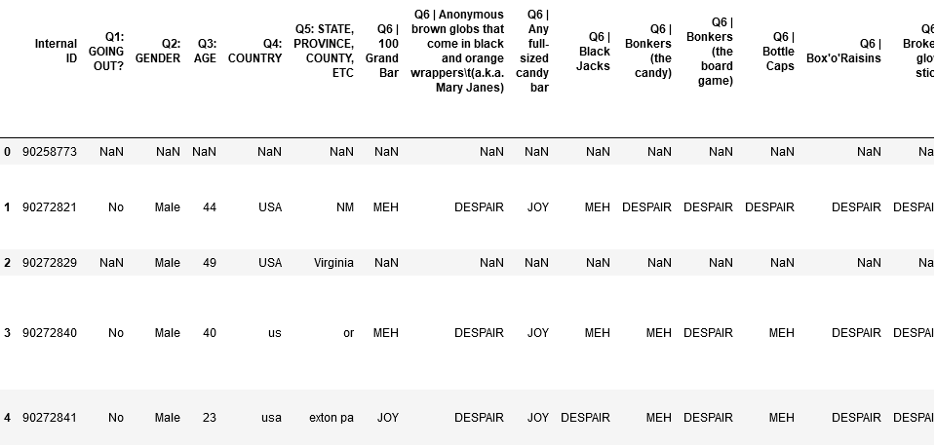
Data Structure
Age, Gender, and Country of Origin
A broad variety of candies and responses of “Joy”, “Despair” and “Meh”
Open survey questions about candies not listed
Other questions not used in this analysis

Slide 5
Output
Plots of candies grouped into types (chocolate, fruit) and analyzed by rating of gender, age, and country
Variable selection for strong links to candy rating
PCA of dataset

Slide 6
Cleaning the Data
Converted “joy”, “meh”, and “despair” to numerical scores
Used natural language processing to clean up country inputs (a drop down list is much better than letting participants write anything they want in, like “Murica”
Pulled other candies not listed in the main survey from participants write-in answers.
Excised categories such as “vicodin” which is in fact not a candy, but a prescription drug.

Slide 7
Participant Statistics
Number of participants: 1803
Mean age of participants: 42.77285223367697
Gender ratio of participants:
Male 60.6%,
Female 34.5%
I'd rather not say 3.4%
Other 1.5%
Top countries surveyed:
Canada 57%
America 26.7%
Germany 2.6%
Netherlands 1.8%
Scotland 1.3%

Slide 8
Candy Statistics
Number of candies: 78
Most popular candy: Almond Joy
Least popular candy: Gum From Baseball Cards
Chocolate candy count: 38
Fruit candy count: 25
Other candy count: 14
Mean Chocolate score: 1.45
Mean Fruit score: 1.05
Mean Other score: 0.85

Slide 9
Cleaning the Data
Converted “despair”, “meh”, and “joy” to numerical scores (0, 1, or 2)
Used natural language processing to clean up country inputs (a drop down list is much better than letting participants write anything they want in, like “Murica”
Pulled other candies not listed in the main survey from participants write-in answers.
Excised categories such as “vicodin” which is in fact not a candy, but a prescription drug.

Slide 10
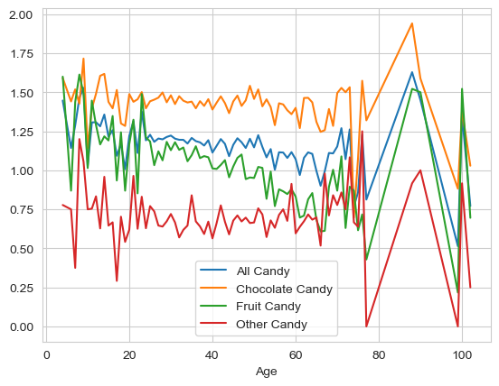
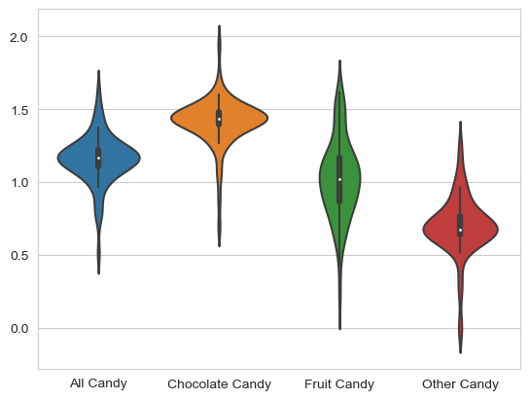
Candy by Age
Data gets spotty and spikes after age 80 due to less data
There seems to be a general trend downward as people get older.

Slide 11
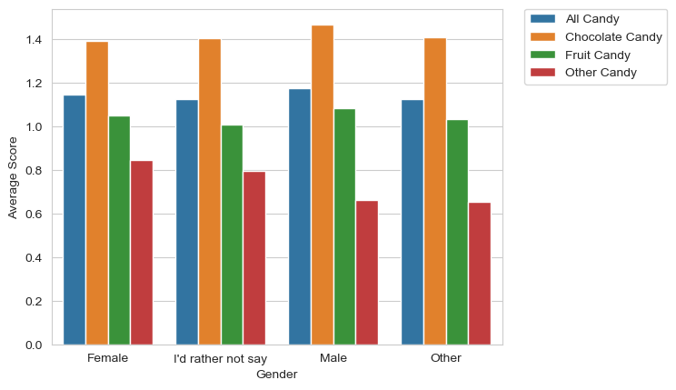
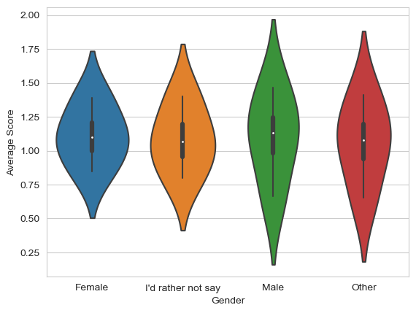
Candy by Gender
Men like chocolate more than women, surprisingly, and like all candy a bit better.

Slide 12
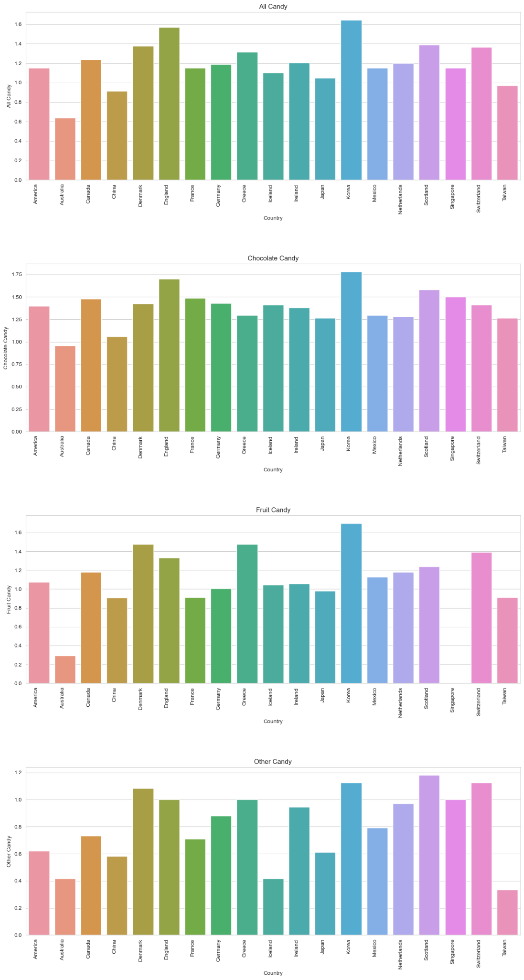
Candy by Country
Korea has the sweetest tooth of any nations surveyed.
Koreans like Chocolate and Fruit candies better than other nations
Scotland seems to really like other flavors in their candy.
Australia likes candy the least.

Slide 13
Conclusions
Much of the data wrangling was unnecessary and could have been avoided with a different design
Stereotypes don’t always hold true, which is why it’s important to study data.
Apparently, people love almond joys.

